Slide 1



UNIT 3; Trends
Lesson 6; In my opinion

Slide 2
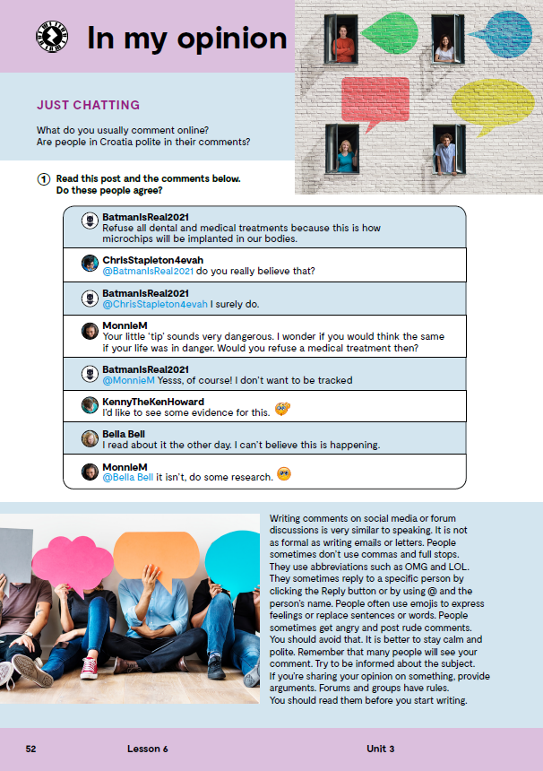
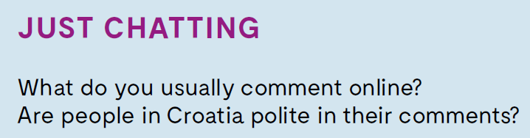
Do you know the meaning of these expressions?
comma
full stop
abbreviation
reply
emoji
argument
avoid
provide arguments
zarez
točka
skraćenica
odgovor
emoji
argument
izbjeći
dati argument

Slide 3

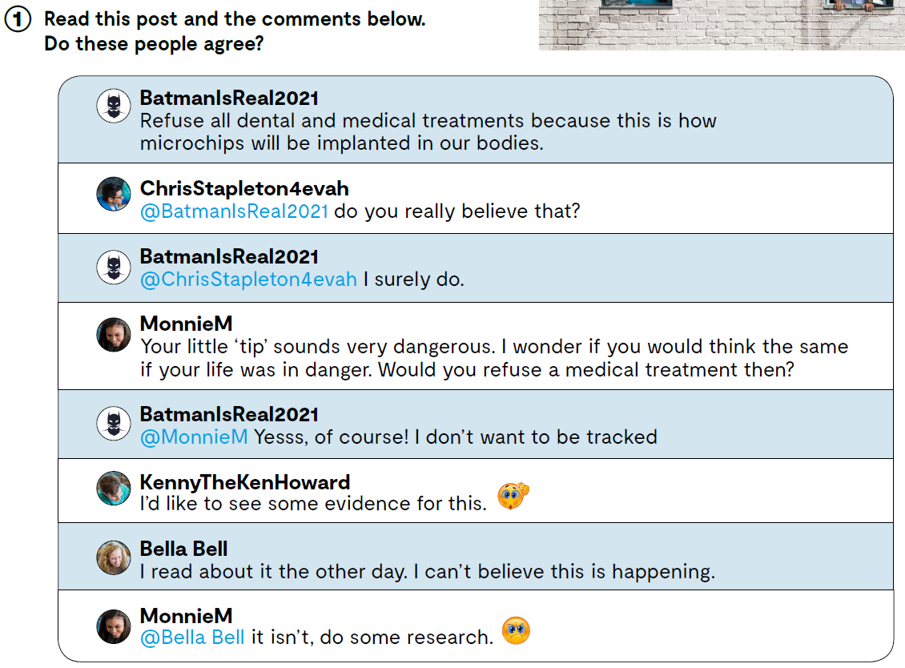
How can you tell?
What is this discussion about?
Do you sometimes write posts?
Do you comment other people’s posts?
Do you usualy agree or disagree with others?

Slide 4
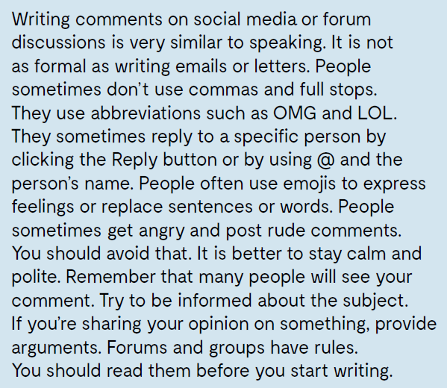
Read this text and think about these questions.
What is writing comments on social media similar to?
What do people sometimes use?
Is there something they don’t use?
How can you reply to a specific person?
What should you avoid?
What should you do when sharing your opinion on something?
What do forums and groups have?
Check what you have learnt. https://wordwall.net/play/12799/000/455

Slide 5
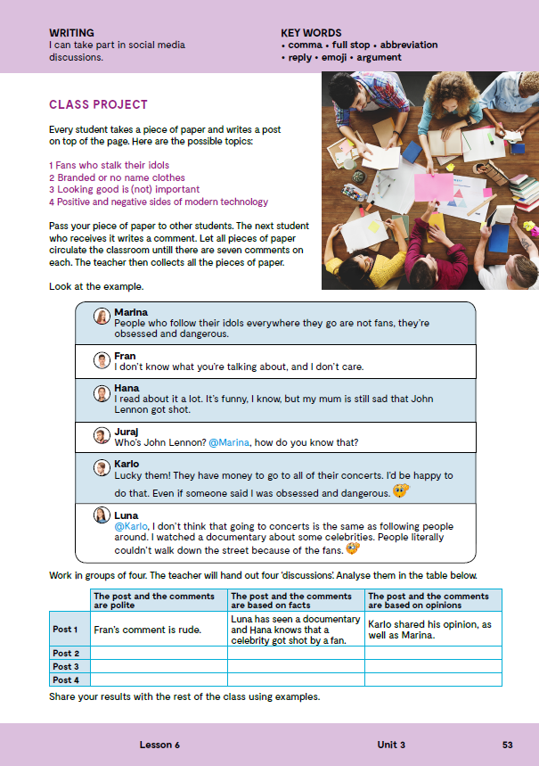
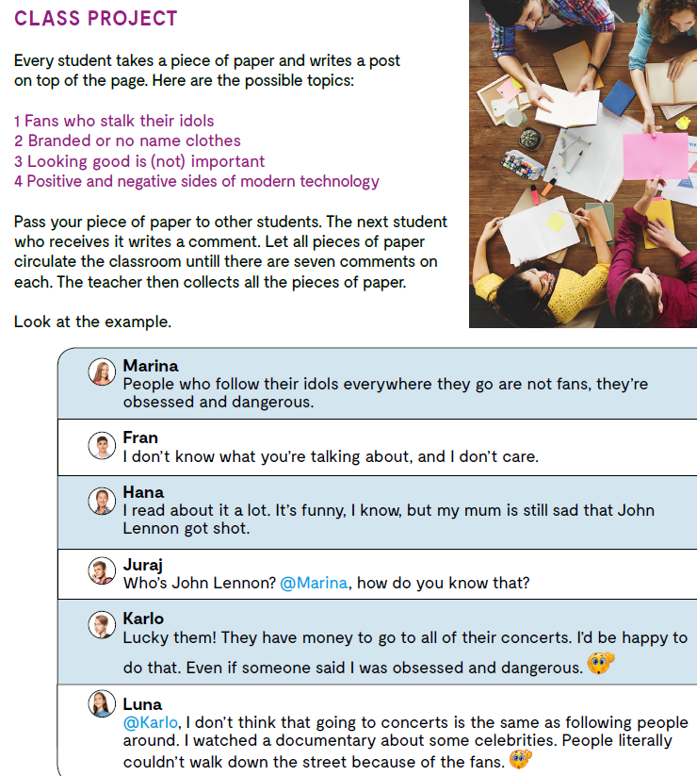
Choose one of the social networks and write a post on one of these topics:
1 Fans who stalk their idols 2 Branded or no name clothes 3 Looking good is (not) important 4 Positive and negative sides of modern technology Send a link of that post to your classmates.
Comment on the post your friends have sent you.
A fact is a statement that can be explained with arguments or scientific data.
An opinion is an expression of someone’s feelings on some topic and cannot be proven or argumented. Opinions can be based on facts or emotions and this is why they are not as reliable as facts.
a fact činjenica
an opinion mišljenje

Slide 6
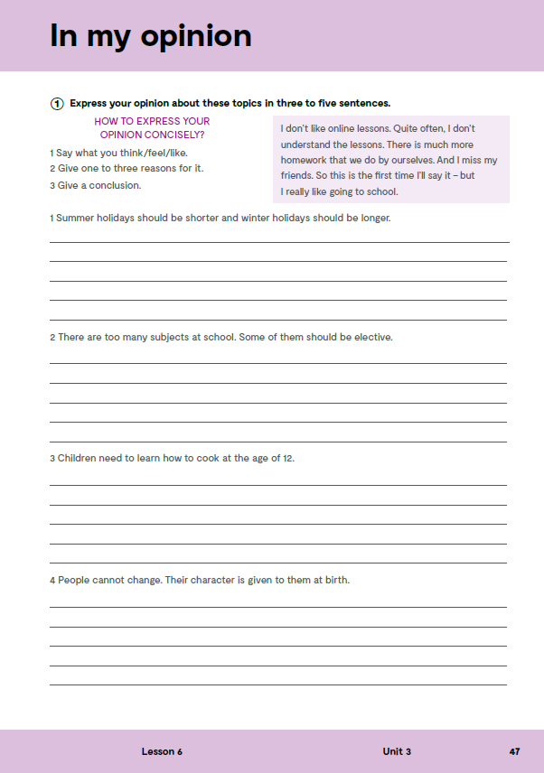
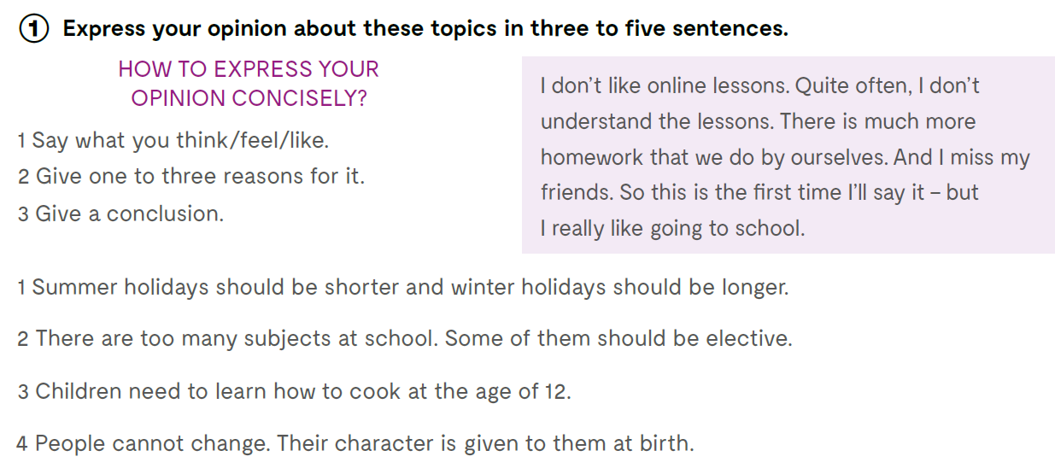
workbook, page 47.

Slide 7

Open the following link and then click on LEARN MORE! https://www.e-sfera.hr/dodatni-digitalni-sadrzaji/7aeda107-fae7-4b21-b316-6e45d47e610a/
The lie is out there Or: Why are conspiracy theories so interesting?
Read the texts about conspiracy theories.
Do the tasks bellow the text.
Create a mind map on the topic of MUSIC.

